Slide 1

Automatic Human Detection in Surveillance Camera to avoid theft activities using Artificial Intelligence
Guided by
Mrs.ChandraPraba
Project by
M. Baranitharan & R. Nagarajan

Slide 2
To avoid the security issues in ATM Centers, we are planned to implement Artificial Intelligence in surveillance camera. An advanced digital Image processing technique along with the combination of computer vision and unsupervised machine learning techniques would be utilized which would create phenomenal results in the detection of the activities and their categorization. If any Criminal activities occur the AI will send the security alert with location, time, images to the security guards.
ABSTRACT

Slide 3
LITERATURE REVIEW

Slide 4
COMPARISION RESULTS

Slide 5
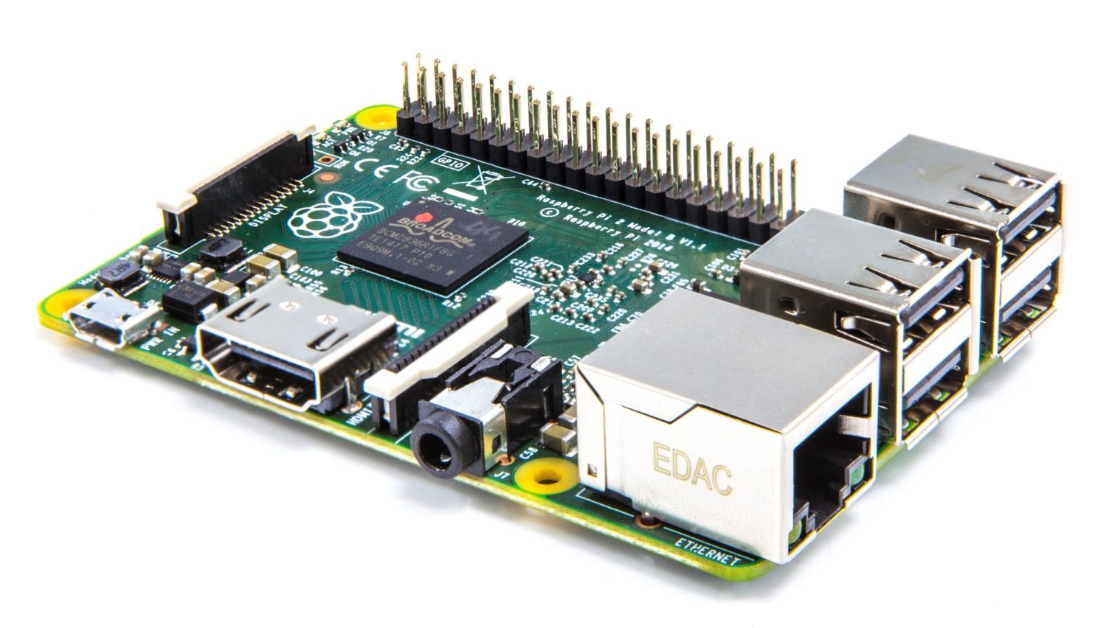
Raspberry Pi-A Credit card size CPU
SYSTEM REQUIREMENTS

Slide 6
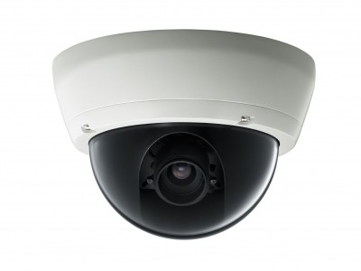
Surveillance camera- To record the environment
SYSTEM REQUIREMENTS

Slide 7

For Live Streaming, even we can use the Vision API for the human Detection
SYSTEM REQUIREMENTS

Slide 8
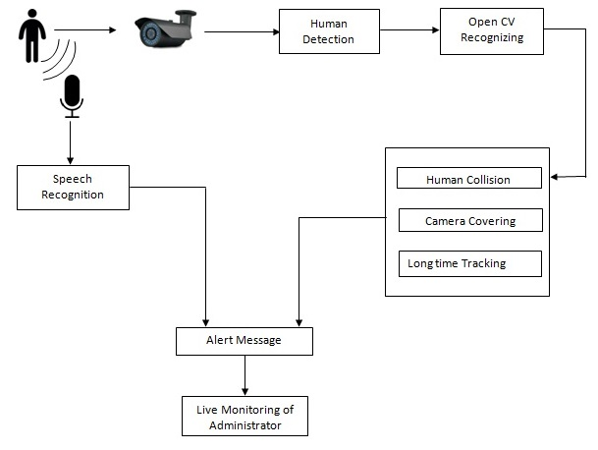
ARCHITECTURAL DIAGRAM

Slide 9
USECASE DIAGRAM

Slide 10
Human Detection
Camera Covering
Human Collision
Speech Recognition
MODULES

Slide 11

ALGORITHM

Slide 12
EXPECTED OUTCOME

Slide 13
CONCLUSION

